Slide 1
TensorFlow

Slide 2
What is Tensor Flow?
TensorFlow is a popular framework of machine learning and deep learning. It is a free and open-source library which is released on 9 November 2015 and developed by Google Brain Team. It is entirely based on Python programming language and use for numerical computation and data flow, which makes machine learning faster and easier.

Slide 3
The word TensorFlow is made by two words, i.e., Tensor and Flow
Tensor is a multidimensional array
Flow is used to define the flow of data in operation.

Slide 4
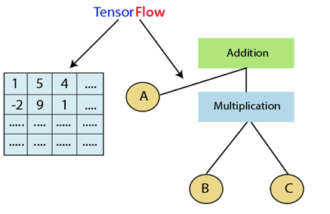

Slide 5
History of TensorFlow
Many years ago, deep learning started to exceed all other machine learning algorithms when giving extensive data. Google has seen it could use these deep neural networks to upgrade its services:
Google search engine
Gmail
Photo
They build a framework called TensorFlow to permit researchers and developers to work together in an AI model. Once it approved and scaled, it allows lots of people to use it.
It was first released in 2015, while the first stable version was coming in 2017. It is an open- source platform under Apache Open Source License. We can use it, modify it, and reorganize the revised version for free without paying anything to Google.

Slide 6
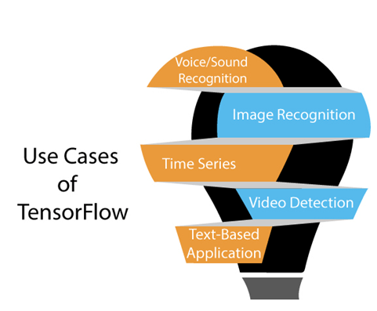
Use Cases/Applications of TensorFlow

Slide 7
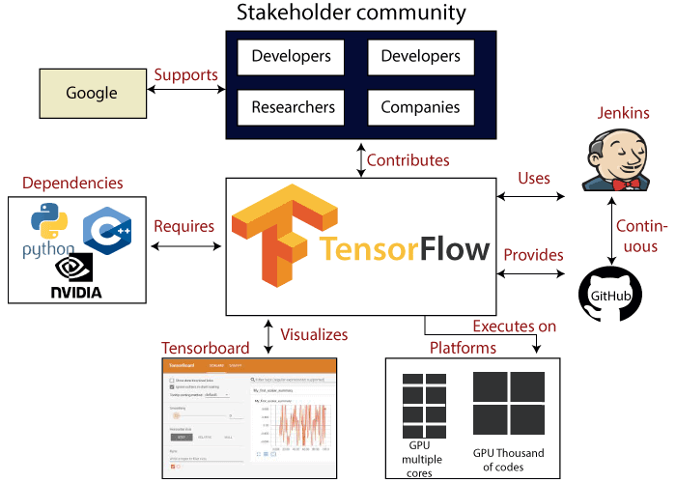

Slide 8
Features of TensorFlow
TensorFlow has an interactive multiplatform programming interface which is scalable and reliable compared to other deep learning libraries which are available.

Slide 9
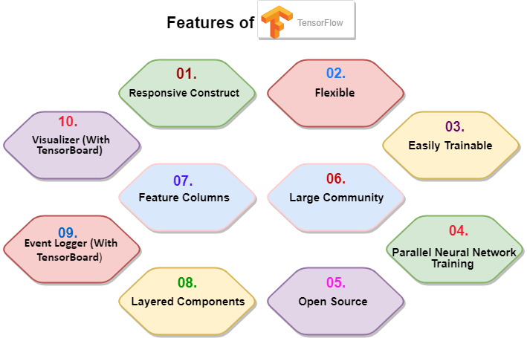

Slide 10
Installation of TensorFlow Through pip
pip3 install -upgrade tensorflow

Slide 11
Testing our TensorFlow
Here, we try and prove whether our new TensorFlow works smoothly without any problems.
Below is an example that you can write to the test.

Slide 12
